Slide 1
AWQ: Activation-aware Weight Quantization for LLM Compression and Acceleration
Sabrina Li, Krithika Ramesh

Slide 2
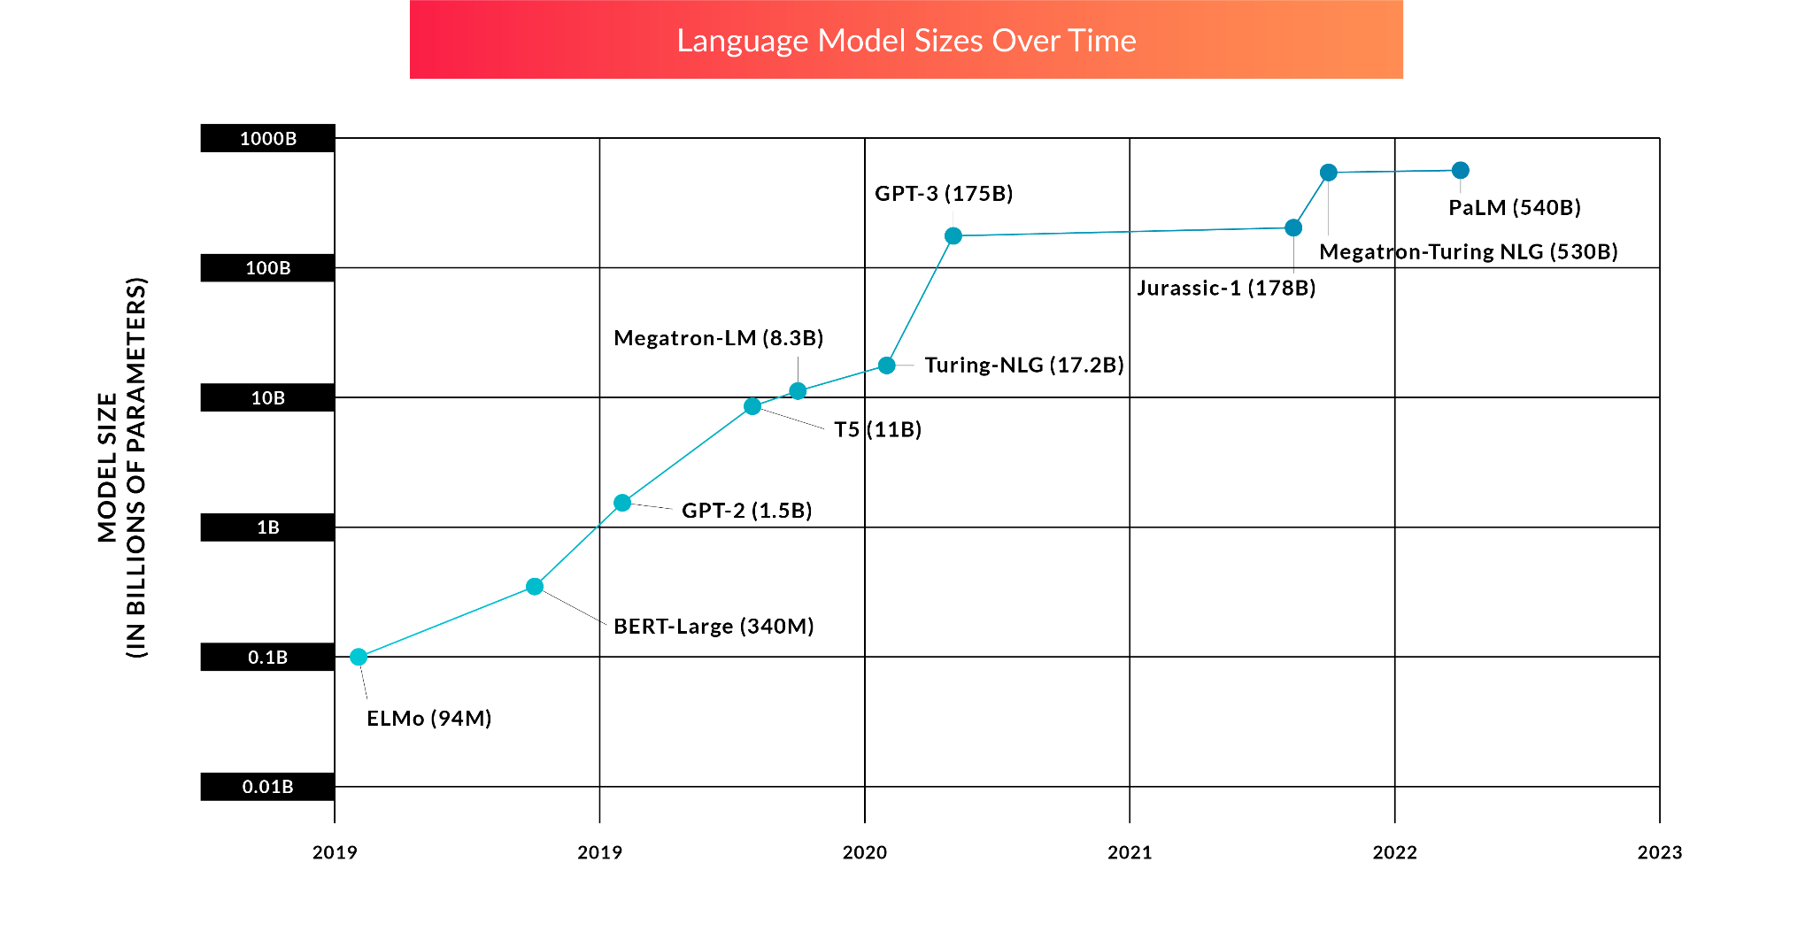
Language models are getting much bigger
Notes:
Two important things to note:
We dropped sesame street character naming convention :(
Model sizes have scaled up rapidly over the years

Slide 3
How can we address the resource-intensive challenges that come with scaling up to larger models (and make every byte count)?

Slide 4
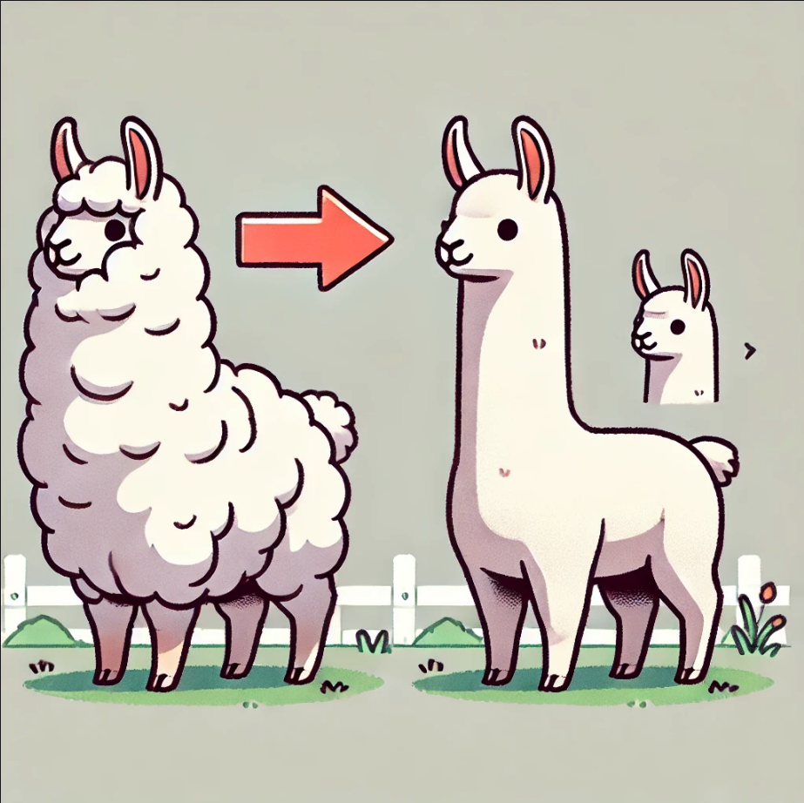
Model Pruning
Ideally, we don’t introduce weird behaviors/artifacts while pruning…
Removes components of the model while (hopefully) preserving performance
Many different types (static/dynamic, structured/unstructured, etc.)
Notes:
Static pruning is done offline (after training but before inference). Dynamic pruning is performed during runtime.

Slide 5

Model Distillation
Knowledge transfer typically done from a larger (teacher) model to a smaller (student) model by minimizing differences in different components of the model
Example: Logits, hidden states, embedding outputs, layer-wise distillation, etc.

Slide 6
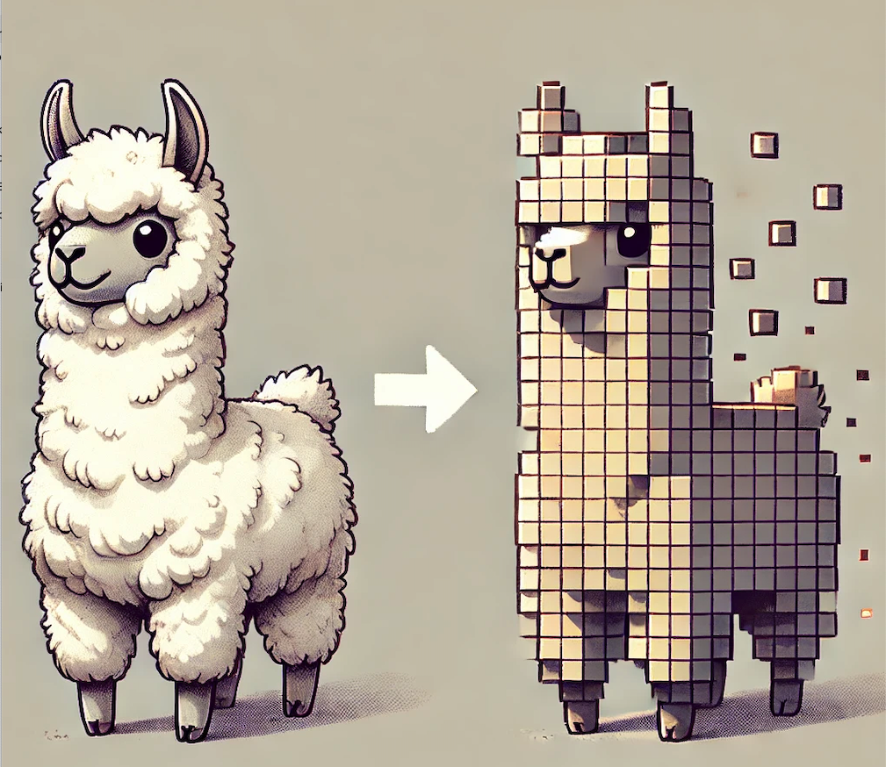
Model Quantization
Doesn’t alter the model architecture, but reduces the memory footprint by simplifying representations into a lower bit precision format
This is what we’re going to focus on today

Slide 7
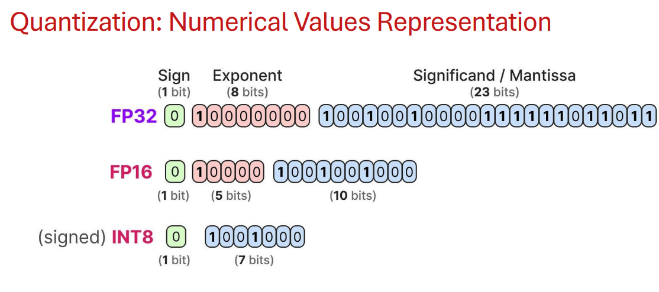
What is quantization?
Quantization is when you represent weights and/or activations with lower-precision data types (for example, converting fp32 to int8)
This reduces memory and computational costs
But, it inevitably leads to some amount of quantization error
Notes:
Equation for conversion of floating point to integer. Every floating point number is represented in the form of a sign bit, the mantissa (23 bits) and the exponent (which is 8 bits)
In the case of 16 bit floating point numbers, the mantissa is shortened (it becomes 10 bits), the sign bit remains ahd the exponent is 5 bits
To accommodate for negative exponents, we shift up the exponent by 127. So an exponent of -126 is stored as 1 in the memory. An exponent of 0 is stored as 127. An exponent of 127 is stored as 254.

Slide 8
Types of quantization
Quantization aware training (QAT)
Forward pass makes use of low-precision weights, but the backpropagation involves gradient estimation methods that maintain the original precision - this reduces the noise from quantization
Scales badly for LLMs
Low precision often leads to training instability, resulting in higher overall training cost
Post-training quantization
This method doesn't involve retraining the fine-tuned/pre-trained model; instead, we use a small calibration set to minimize the error from quantization by determining the scale and the zero point, which determine the range of values that the of the layers will map to when converted to lower-bit precisions.
Notes:
(Note: My understanding is that QAT sucks purely because of the resource-drain - a lot of these methods were proposed for encoder models, etc and iirc, they are sensitive to changes in hyperparameters and things like that, so not particularly cost-effective. Can add citations later.).

Slide 9
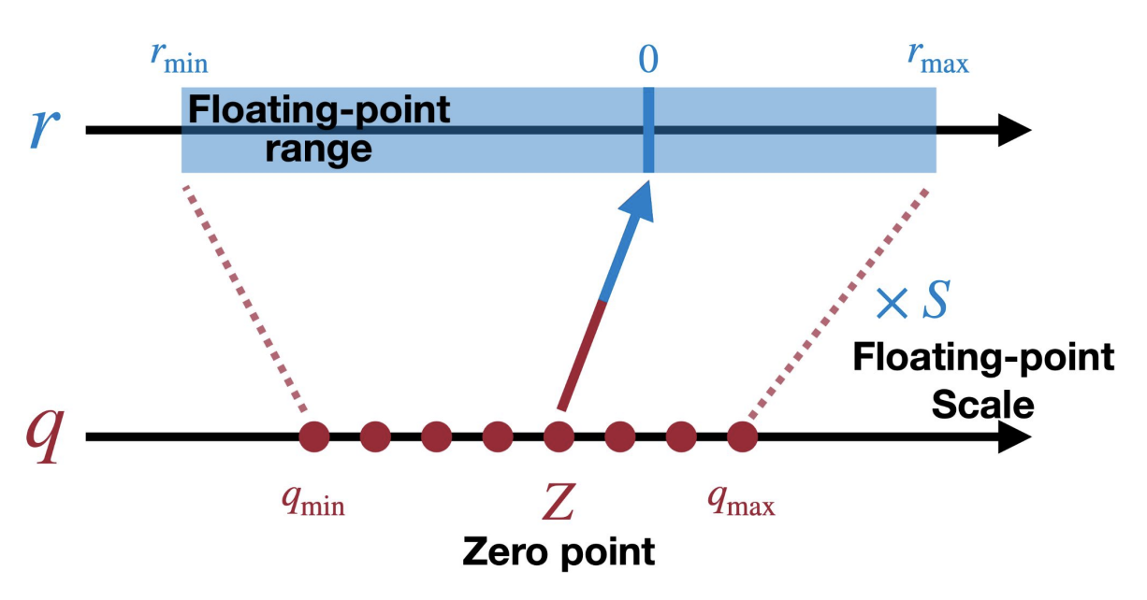
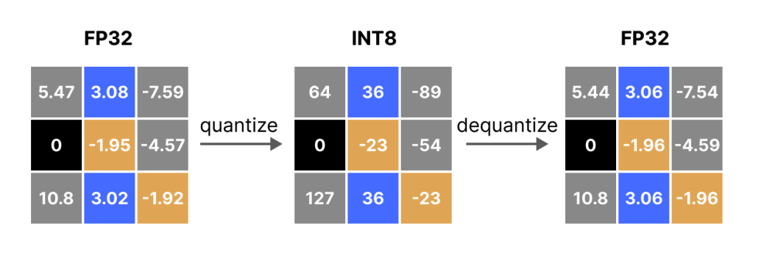
Mapping from fp to ints and back
Notes:
The general intuition for how quantization works is that weights are usually floating points. For example, fp32. But we don’t want to store the weights as fp32 because that would use a lot of memory. So instead, we quantize these weights by converting them to INT8 and storing them that way. At inference time, we then convert them back to fp32 (though with a small amount of inaccuracy) before multiplying these with the input.
Something to note is that there’s different quantization methods. Today we’re going to focus on absolute max quantization which is a linear quantization method. Absolute max quantization also assumes that the weights are centered around z = 0, so we don’t need to worry about calculating the zero-point.

Slide 10
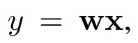
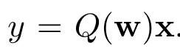
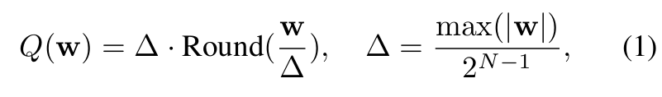
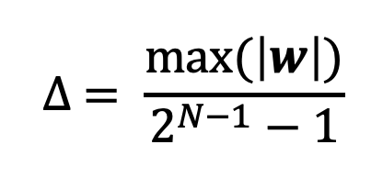
Linearly quantizing a layer
Original layer:
Layer after quantization:
Quantization function (using absolute max quantization):
N is the quantization bits, ∆ is the quantization scaler
Note: there is a typo in the paper
Quantized weights
Notes:
You can think of Q(w) as an approximation for w. The quantization function here is how this approximation is done. On the right side, in the green box, are the actual quantized weights. On the left is the scaling factor for converting between the floating-point range and the quantized range (ints).
The idea behind scaling is that it reduces the quantization error. The gist of the quantization scaler is to sort of normalize the quantized weights and make them ‘relative’ to one another (this reduces the distortion that might come with mapping the weights to another space). Our goal is to minimize the rounding error, and down the line, it would help backpropagation (better convergence). For the scaling with the scaling factor s, we’re applying it to specific layers, that’s a bit different.

Slide 11
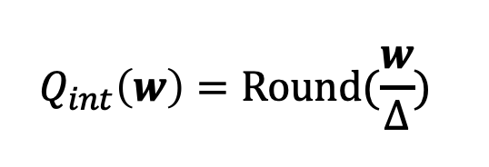
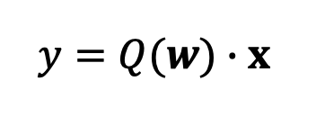
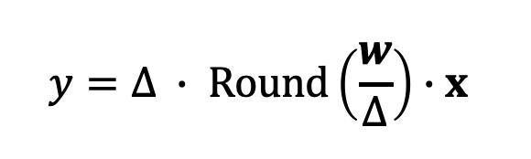
Just to be clear about notation:
These are the quantized weights (which are stored):
Q(w) is the quantization function:
The overall layer (after quantization) looks like this:
Notes:
You can think of the quantization function as an approximation for the original w using the quantized weights. So, you can imagine how the quantized weights are INT4 or INT8 while the original weights are fp32. By multiplying these INT4 or INT8 weights by the scaling factor, we “reconstruct” the original w during inference time.
by reverse scaling the quantized weights and thereby reconstructing w

Slide 12
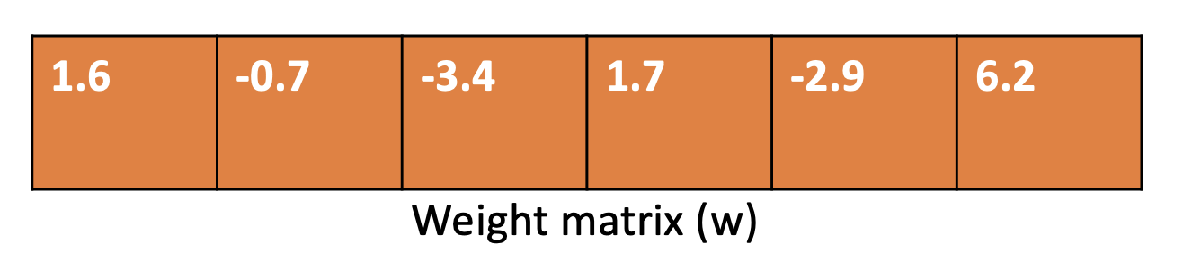
Absolute Max Quantization Example
Given a weight matrix (w) that we want to quantize to INT4
INT4 has a range of [-8, 7] (two’s complement system).
In practice, we clip the negative range to make it symmetrical → [-7, 7]

Slide 13
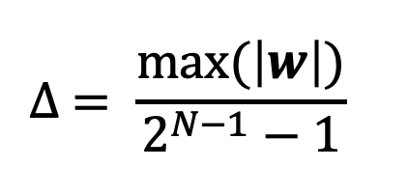
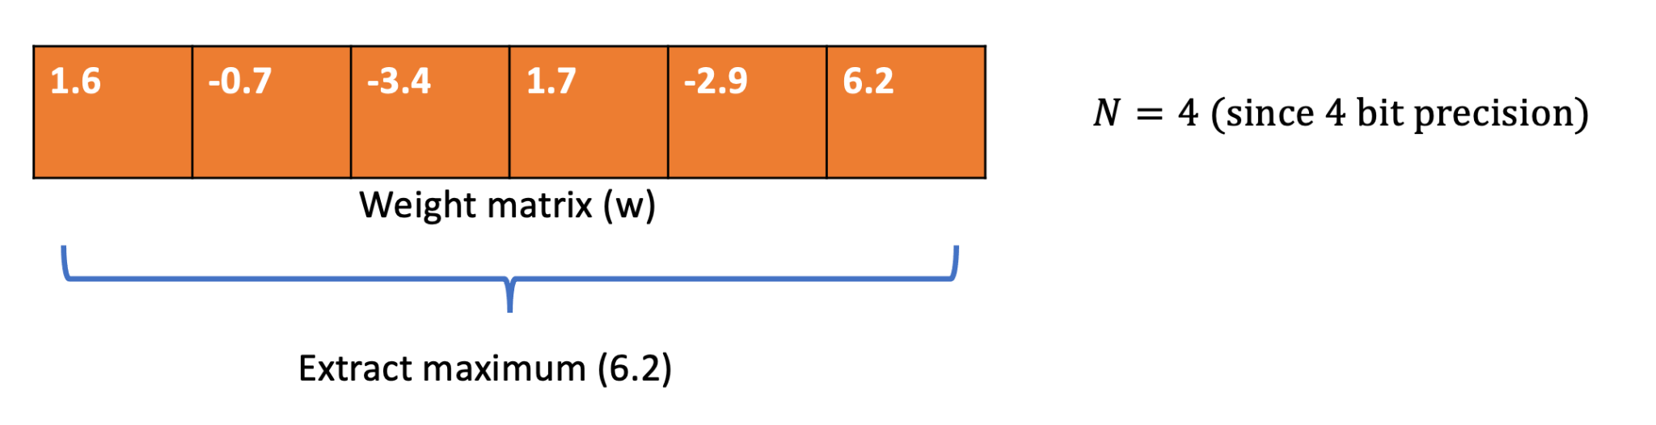
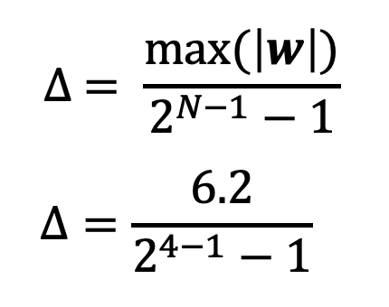
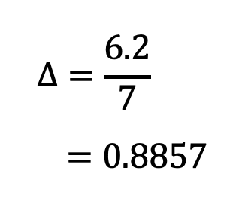
Absolute Max Quantization Example - calculating the scaler ∆
Start by calculating quantization scaler (∆):

Slide 14
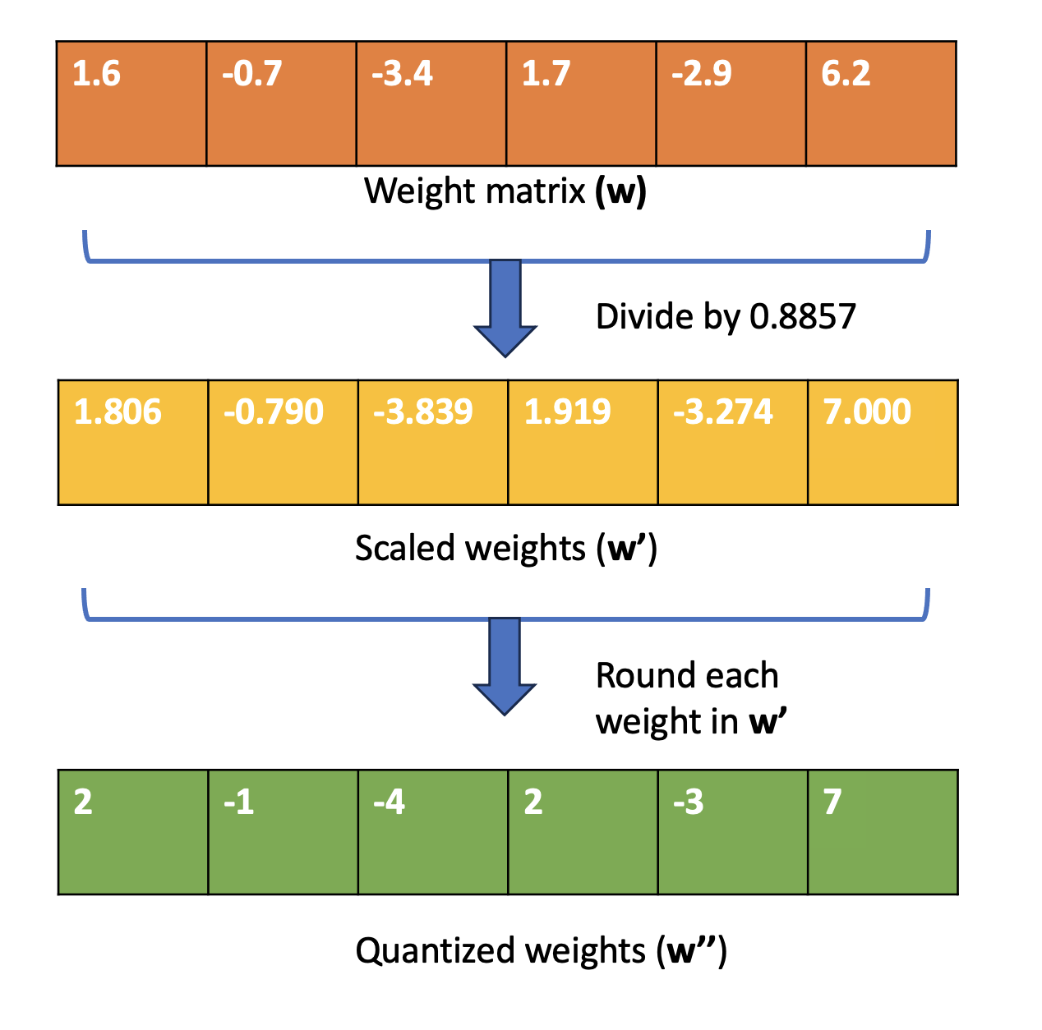
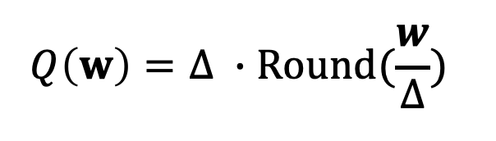
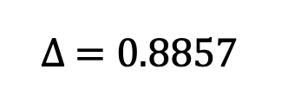
Deriving the quantized weights:
Notice that all weights in w’ and w’’ are within the range of [-7, 7] as we would want for INT4
Yay, our weights are now quantized!
Notes:
Need to edit to add the sign bit

Slide 15
What about at inference time?

Slide 16
Looking at the quantization function again
Quantized weights (these are saved/stored)
Reconstruction process: scale back up quantized weights before multiplying with input x
Benefit: we only store the quantized weights (low bit ints) and the scaling factor ∆ (float). This is better than storing an entire weight matrix of floats

Slide 17
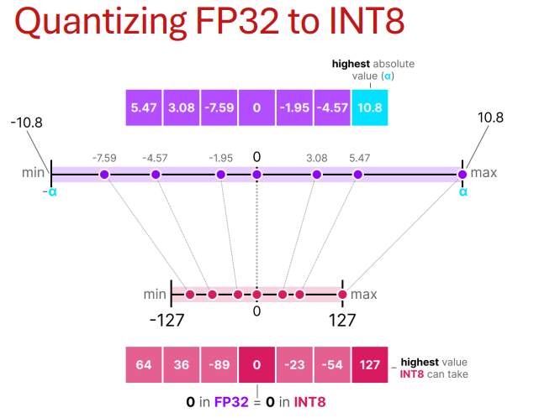

Slide 18
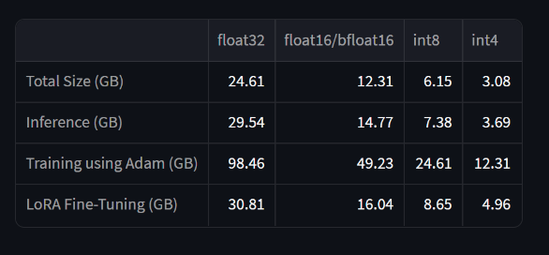
Memory consumption in GB for codellama/CodeLlama-7b-hf

Slide 19
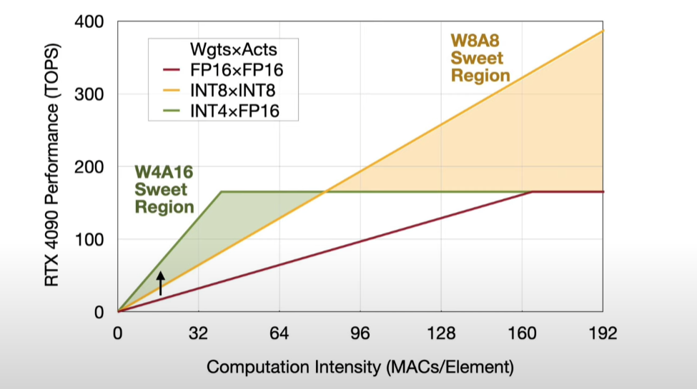
Why do we only quantize the weights and not the activations?
W8A8 quantization (both activations and weights are quantized to INT8)
Low-bit weight-only quantization (ex: W4A16) - only weights are quantized into low-bit ints
Pros: requires smaller memory size, speeds up token generation
Cons: current methods like GPTQ overfit the dev set and may not preserve generalist abilities of LLMs
Notes:
For lower computational intensity, when the number of sequences, number of channels (batch size basically for the num seq part) is limited, then w4a16 is better

Slide 20
All weights are important, but some weights are more important than others.

Slide 21
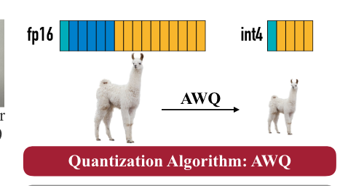
What does AWQ try to do and how is it different from other methods?
The intuition: some weights are more important than others. Don’t quantize the most important (salient) weights.
This should reduce overall model degradation due to quantization error
AWQ is a quantization algorithm that is sensitive to the saliency of weights
Weight magnitude is not used to determine weight importance
Instead, using the magnitude of the activation demonstrates significantly better results
Notes:
They postulate that the activation >>> based on results from previous papers, I believe
Empirically they show that random selection is effectively the same as filtering on the basis of weight magnitude

Slide 22
How do we protect salient weights during quantization?
Skipping the quantization of weights that significantly influence LLM performance should reduce the quantization loss.

Slide 23
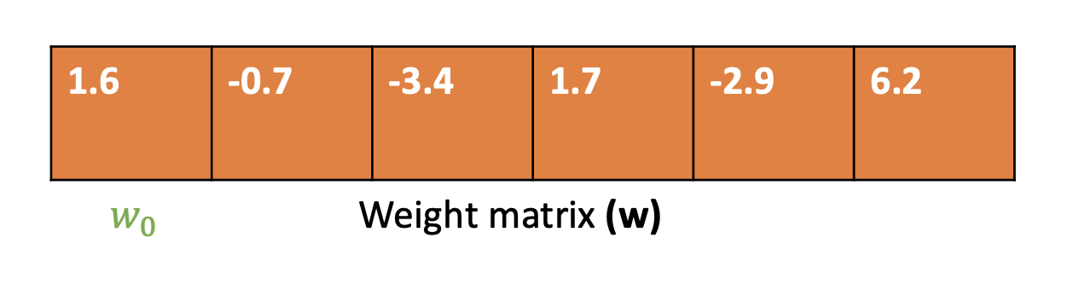
Scale them!
Intuition: when weight values are small, they are more susceptible to quantization error due to rounding
By scaling up an element in the weight matrix w by a factor of s before quantizing it, we protect this element during the quantization process
Notation Warning!
w (not bolded) represents one weight in the weight matrix w (bolded)

Slide 24
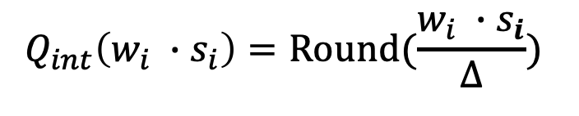
Scale them! - continued
Instead of:
We have:
Quantize the entire weight matrix directly.
For each element w_{i} in the weight matrix w, multiply it by s_{i} and then quantize

Slide 25
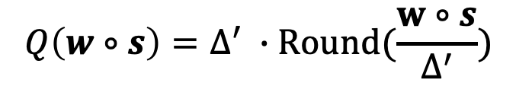
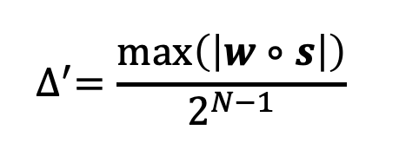
What does the quantization function look like now?
where the quantization scaling factor is
Before:

Slide 26
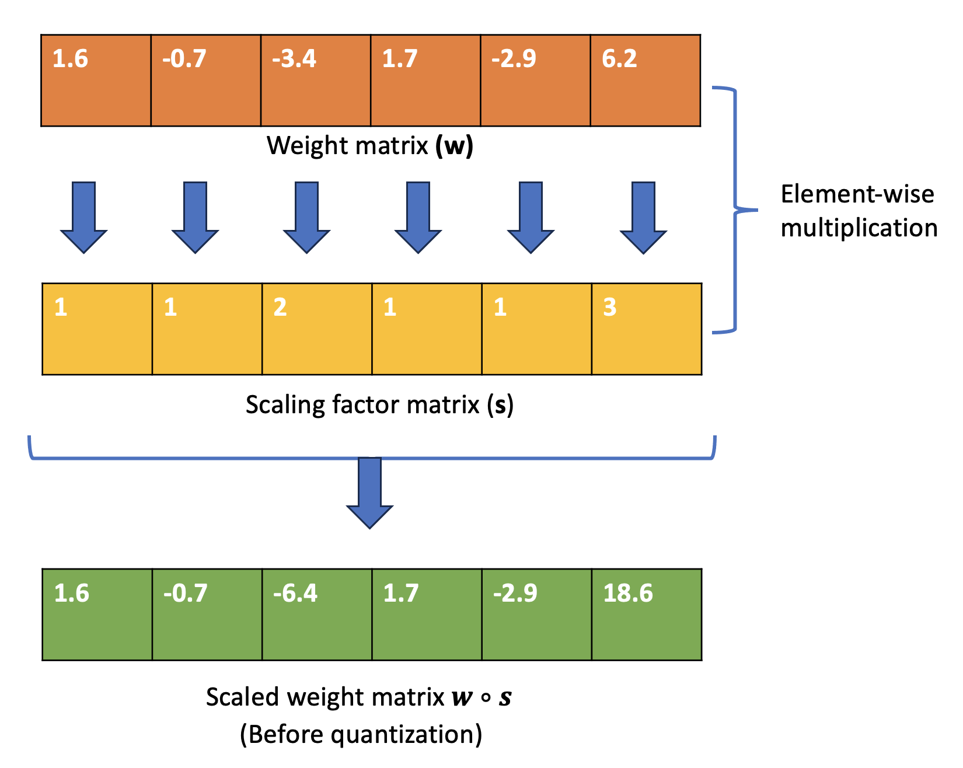
Scaling weights before quantization (intuition)

Slide 27
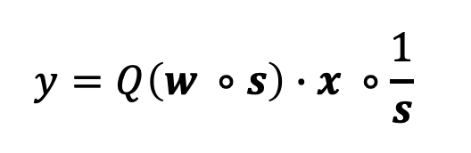
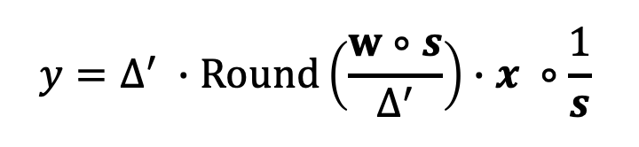
What the quantized layer looks like (when applying weight scaling):
Since we scaled up the weight matrix w by a factor of s, we will want to multiply by 1/s before getting our result

Slide 28
Empirical observations about scaling and quantization error:
Rounding error is not affected by scaling (error caused by converting floating-point to integer is roughly uniformly distributed [0, 0.5] with average error of 0.25)
Scaling up an element w_{i} does not usually change the maximum value in w so ∆’ ≈ ∆
∆ and x are represented in FP16 and have no quantization error
for reference

Slide 29
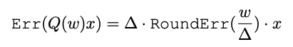
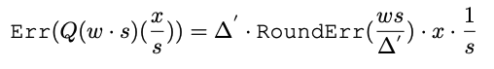
Quantization error:
Quantization error for non-scaled weights (s = 1):
Quantization error for scaled weights (s >= 1):
Given the observations from the last slide, the quantization error is smaller for weights with s > 1.

Slide 30
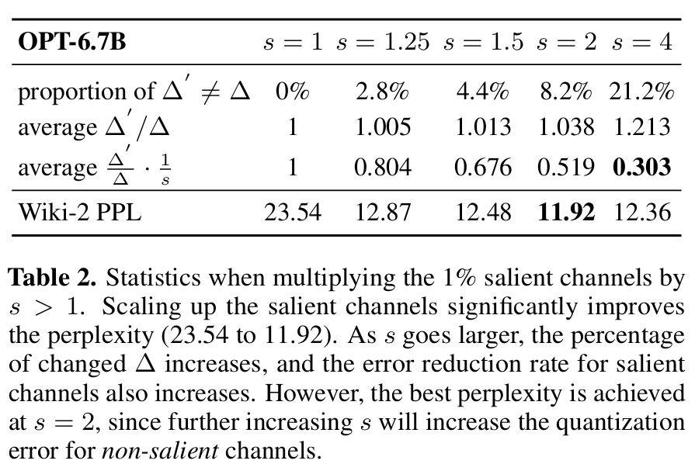
Effect of generally increasing scale-up for weights
While the quantization error of salient channels continues to go down as s is increased, this eventually comes at the cost of non-salient channel quantization error (the relative error over non-salient channels increases)

Slide 31
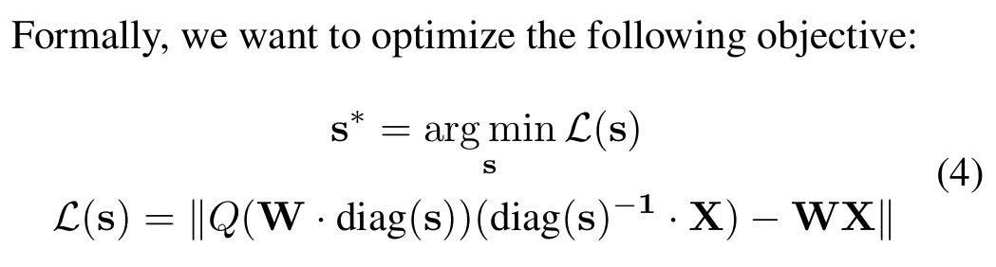
How do we determine the per-input channel scaling factor?
Unfortunately, we cannot optimize this directly because the quantization function (Q) is not differentiable.

Slide 32
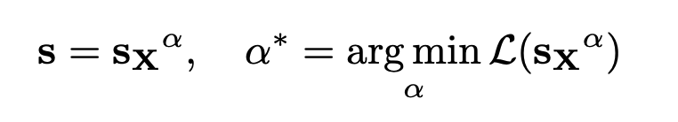
Solution: grid search over exponent for magnitude of activation
s_{x} is the magnitude of activation for a given channel
α is the hyperparameter (ranging from [0, 1]) we perform grid-search over
When α is 0, we get s = 1 (aka no upscaling of weights)
When α is 1, we get s = s_{x} (upscaling is equal to magnitude of activation)
Intuitively, we want the α that gives us the best trade-off between minimizing the quantization error for salient vs non-salient weights
Notes:
Why do we do per-channel scaling vs per-layer of scaling? Ans: Less variance in the distributions of weights across each channel vs across each layer

Slide 33
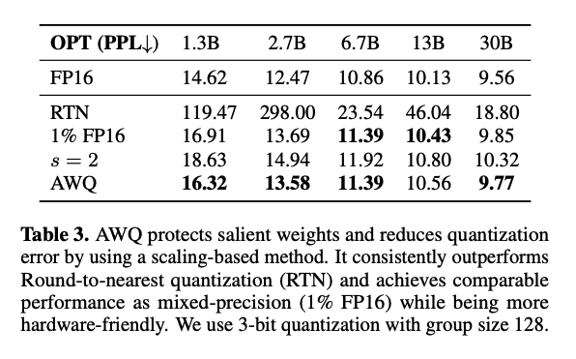
AWQ performance compared to other quantization strategies
Round to Nearest (RTN):
the process we went through before for quantization with no scaling applied
1% FP16:
Keep the top 1% of weights in FP16 while quantizing the rest to INT8.
AWQ tends to achieve lower perplexity for OPT than other quantization strategies
Notes:
Mixed precision training takes longer

Slide 34
Dequantization
Not a trivial process, especially since we have mixed data type in W4A16
If we remember the simplified quantization process from before (without the upscaling):
INT4
FP16

Slide 35
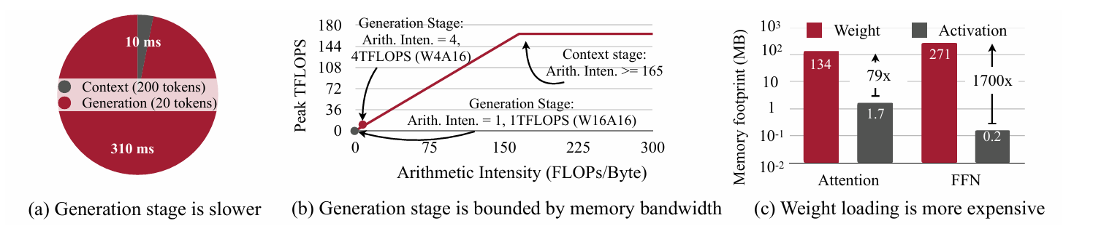
How can AWQ accelerate on-device LLMs?
Profiling LLaMA-7B:
Generation is much slower than context-based tasks
310 ms for generation; 10 ms for summarization
Generation stage is memory-bound
Weight access dominates memory traffic - therefore, more effective to quantize weights instead of activations
Notes:
Takes 310 ms to generate 20 tokens, while summarizing a prompt with 200 tokens takes only 10 ms

Slide 36
Experiments evaluating AWQ
Models
Llama and OPT families
OpenFlamingo & LLaVa-13 B for multimodal eval
Vicuna for instruction-tuning related tasks
Datasets
Perplexity eval on WikiText-2
COCO for multimodal captioning + 11 visual language benchmarks
MBPP and GSM8K datasets

Slide 37
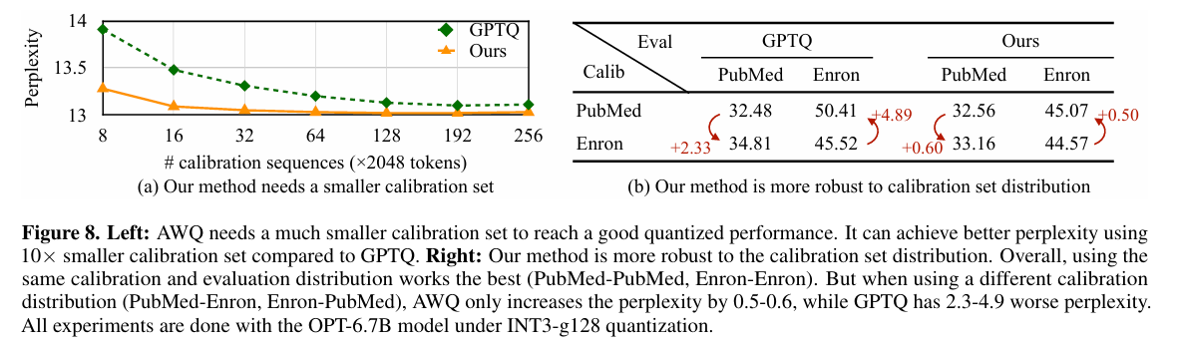
Pros of AWQ
No reliance on regression/backpropagation (since we only need to measure the average activation scale on the calibration set)
It needs far less data in its calibration set to achieve the same performance compared to GPTQ
Only needs 16 sequences vs 192 sequences (10x smaller set)
It overfits less to the calibration set; when switching calibration sets, perplexity increase is less than for GPTQ

Slide 38
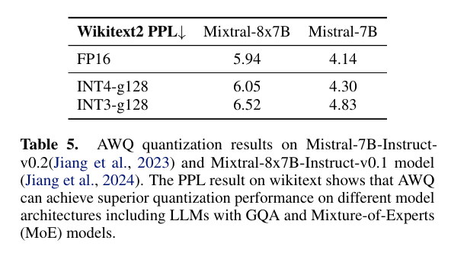
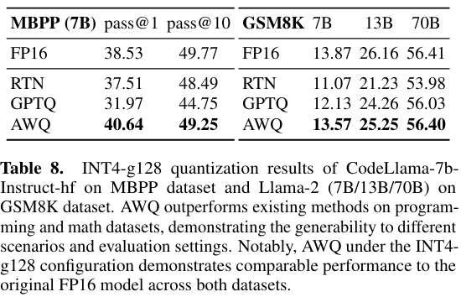
Performance of AWQ under different settings/tasks
AWQ quantization shows good results for Mistral and Mixtral
AWQ quantized models perform better than other quantized models on programming and math datasets (MBPP, GSM8K)

Slide 39
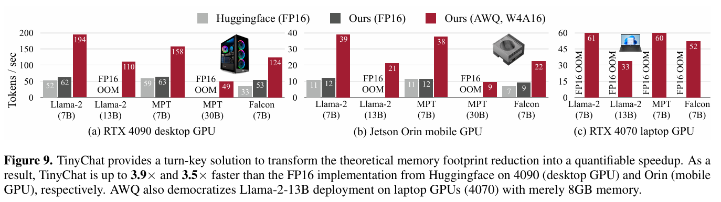
Speed-up comparison across models (FP16 vs AWQ, W4A16)

Slide 40
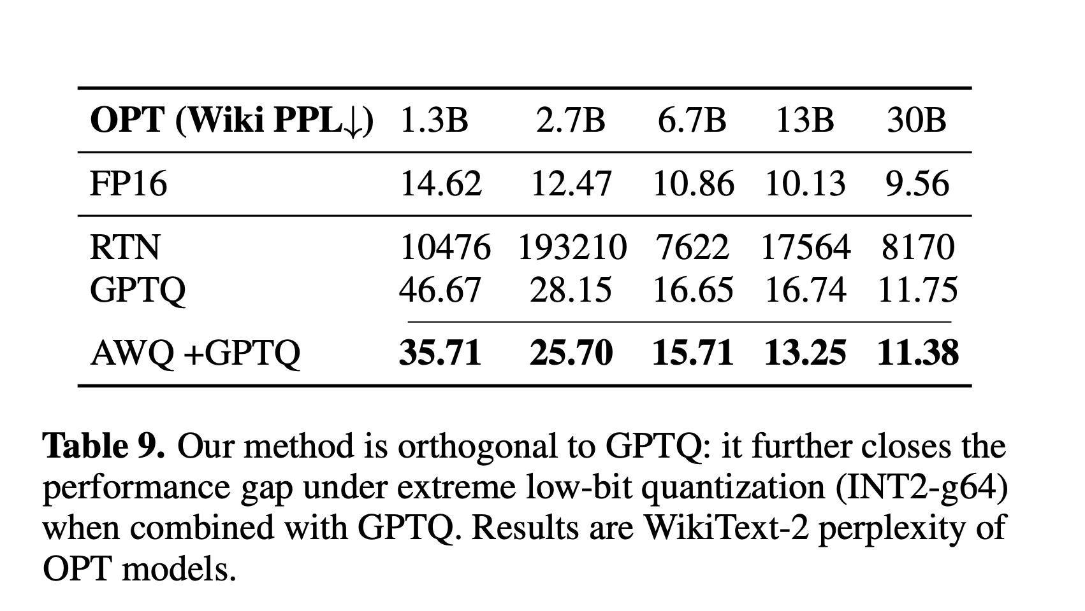
AWQ can be combined with GPTQ for better extreme low-bit quantization
Notes:
GPTQ: one-shot (post-training) weight quantization method that can quantize down to 3 or 4 bits per weight (in comparison to previous methods that are only accurate to about 8 bits). It takes a layer by layer approach to quantization and relies on second-order optimization of the quantization loss. It is based on OBQ, which is a greedy algorithm (starts with the weight which incurs the least additional quantization error). GPTQ quantizes the weights of all rows in the same order

Slide 41
Summary of AWQ’s Contributions
AWQ allows us to perform low-bit weight specific compression
Activation magnitude can indicate weight saliency
Reducing quantization loss over salient weights improves performance
Performance gains over previous post-training quantization approaches across multiple tasks. Orthogonal to method proposed in GPT-Q paper.
Theoretical memory savings can improve speedup over FP16 implementations of resource-constrained models
Across a variety of architectures and tasks, AWQ achieves performance that is nearly on par with FP16

Slide 42
Appendix

Slide 43
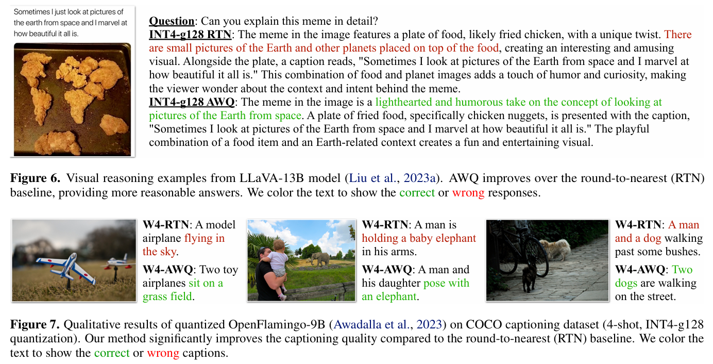
Improvement compared to other quantization methods for LLaVA-13B and OpenFlamingo-9B on COCO captioning; RTN produces incorrect captions

Slide 44
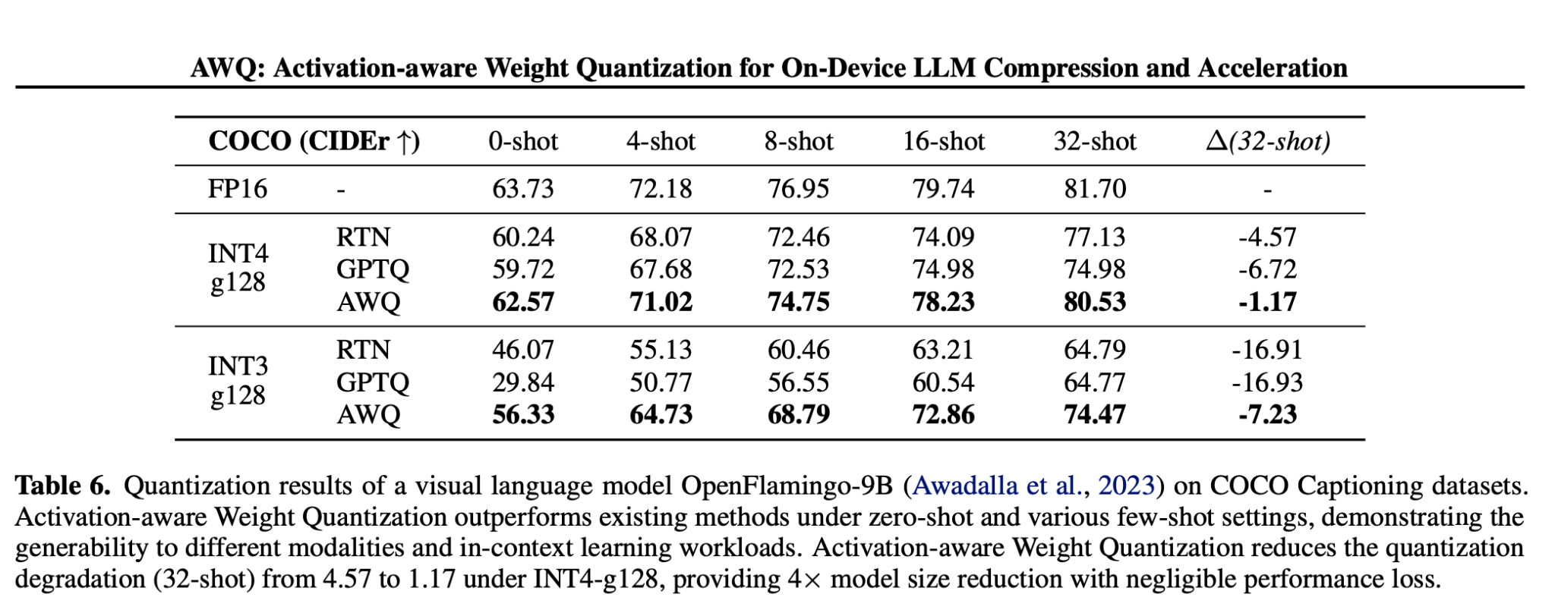
Multi-shot performance of OpenFlamingo-9B with different quantization methods
Notes:
Only the LLM part of this is quantized (since it dominates the model size). The loss is minimal when using AWQ

Slide 45
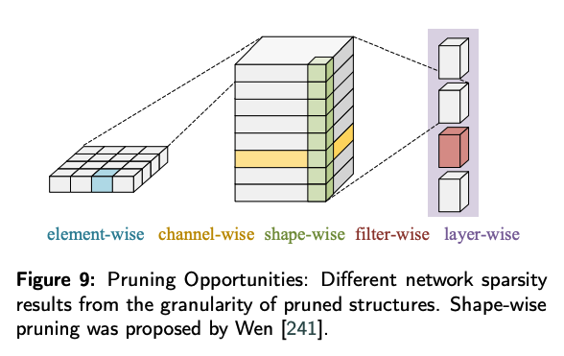
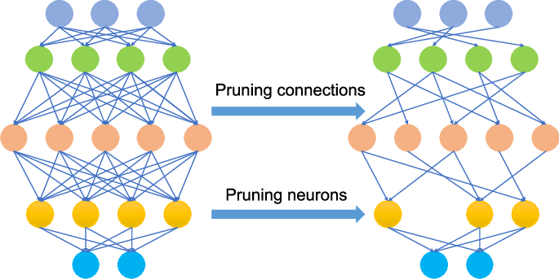
Model Pruning
Notes:
Static pruning is done offline (after training but before inference). Dynamic pruning is performed during runtime.

Slide 46
Linearly quantizing a layer
Original layer:
Layer after quantization:
Quantization function (using absolute max quantization):
N is the quantization bits, ∆ is the quantization scaler
N - 1 because 1 bit is reserved for the sign
Quantized weights
Notes:
You can think of Q(w) as an approximation for w. The quantization function here is how this approximation is done. On the right side, in the green box, are the actual quantized weights. On the left is the scaling factor for converting between the floating-point range and the quantized range (ints).
The idea behind scaling is that it reduces the quantization error. The gist of the quantization scaler is to sort of normalize the quantized weights and make them ‘relative’ to one another (this reduces the distortion that might come with mapping the weights to another space). Our goal is to minimize the rounding error, and down the line, it would help backpropagation (better convergence). For the scaling with the scaling factor s, we’re applying it to specific layers, that’s a bit different.

Slide 47
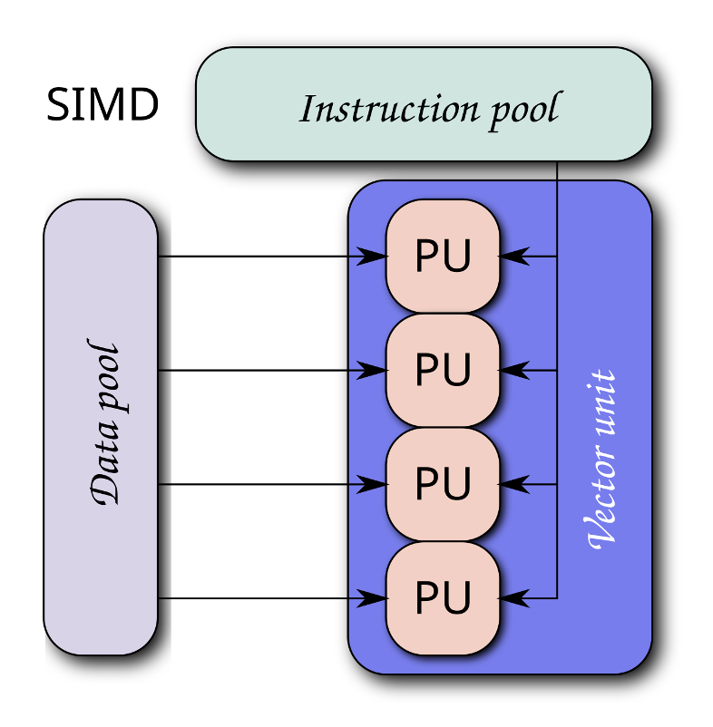
TinyChat
What is TinyChat?
A system for AWQ model inference that handles the many problems with de-quantization while ensuring speed
Properties of TinyChat:
On-the-fly weight de-quantization
SIMD-aware weight packing
SIMD (single instruction, multiple data): a parallel computing paradigm
TinyChat should try to take advantage of SIMD and should thus use platform-specific weight packing
Kernel Fusion
Attempt to fuse all operators into a single kernel to minimize number of separate operations

